Slide 1
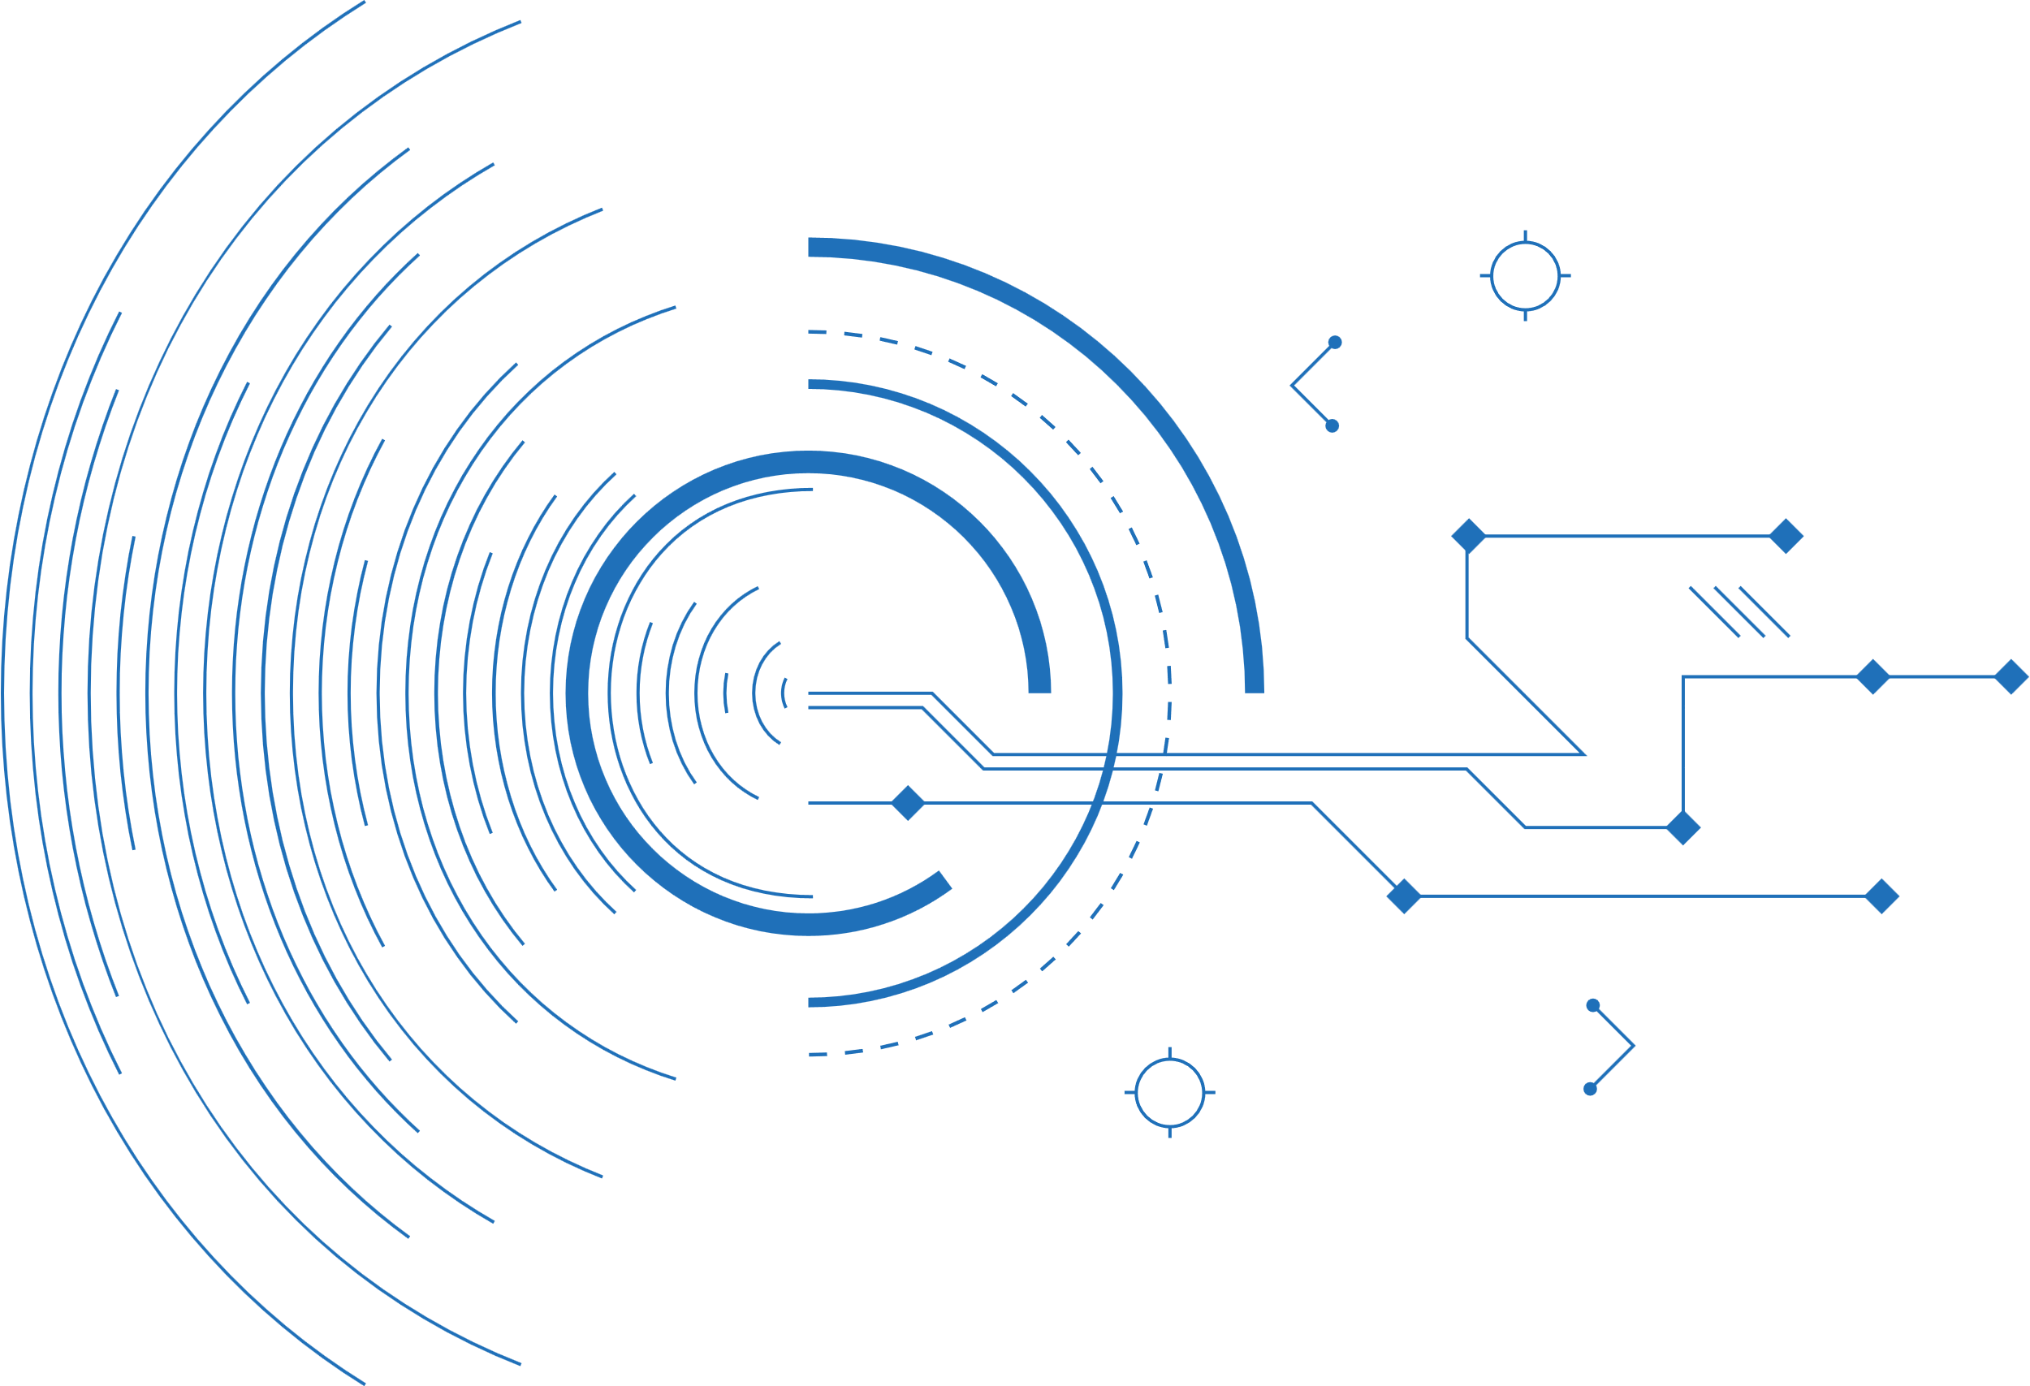


MVVM in Blazor
With the Community Toolkit
KELLY ADAMS

Slide 2


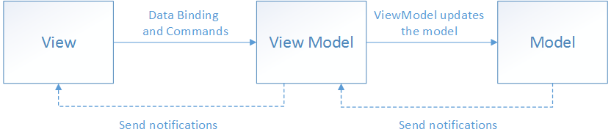

Why MVVM?
REDUCED RISK:
If an existing model implementation encapsulates existing business logic, it can be difficult or risky to change it.
UI/PLATFORM AGNOSTIC: The app UI can be redesigned without touching the view model and model code, provided that the view is implemented entirely in markup. Therefore, a new version of the view should work with the existing view model.
1
3
TESTABILITY:
Developers can create unit tests for the view model and the model, without using the view. The unit tests for the view model can exercise exactly the same functionality as used by the view.
COLLABORATION:
Designers and developers can work independently and concurrently on their components during development. Designers can focus on the view, while developers can work on the view model and model components.
2
4
Notes:
1- In this scenario, the view model acts as an adapter for the model classes and prevents you from making major changes to the model code.
2- Everybody likes tests but hates writing UI tests.
3- Can go from web to mobile to desktop with a lot of code re-use
4- Let’s face it-- we are generally not great UX/UI engineers

Slide 3



File…New Project
Let’s start off with a brand new Blazor WASM project with an ASPNet core host on the backend. Also add a test project so we don’t forget to test things as we go.

Slide 4

Wire-Up Community Toolkit
Add the CommunityToolkit.Mvvm v8.0 package
Add an interface and base class for ViewModels
Create a base class for components (and pages) that handles initialization and propagating change events to Blazor
Change our first model to be an ObservableObject
https://github.com/CommunityToolkit/dotnet

Slide 5

Component-ize Example Fetch Data page
Add our first ViewModel
Remove code from the View and handle in the VM
Register our VM with dependency injection
Write our first test
Notes:
Hooray for code-gen magic!

Slide 6

Setup Messaging Between Components
Create a new VM base that extends ObservableRecipient and registers as an IRecipient<T>
Remember to set IsActive when loaded to receive messages
Create some message objects
Implement the Receive handlers to do work and update observable properties
Make some simple Views to bind to the viewmodels
MOAR TESTS!
Notes:
Notice how we don’t need EditContexts or Cascading properties to communicate between the components
The page view is blissfully unaware that the two components on it are talking back and forth

Slide 7

Form Validation
Create our own ValidationSummary that is aware of ObservableValidator HasErrors and GetErrors
Add a model we want to validate
Add a regular VM that has an observable model that is validatable
Notes:
Notice that we can’t use CodeGen on ContactInfo because we need to call the SetProperty overload that validates first.

Slide 8
THANK YOU
www.intellitect.com

Slide 9

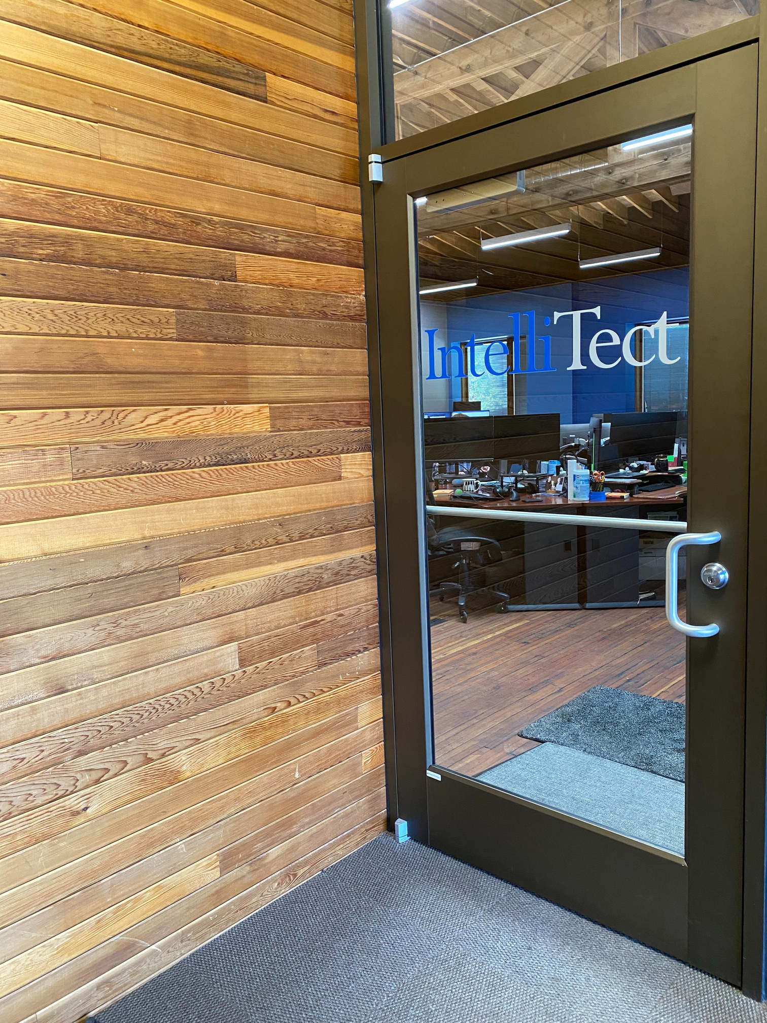




Contact Us
Looking for a custom software solution but not sure where to start? Have a specific project in mind and need help from a tech consultant? Contact us and let our team use their years of expertise to design the perfect solution for your business.
(509) 315-3400
www.intellitect.com
info@intellitect.com
1720 W 4th Ave Unit B, Spokane, WA

